Slide 1

Business Intelligence (BI) Software Implementation
Presented By: Subhojit Mukherjee
Dated On: 17.01.2025

Slide 2

Definition
Business Intelligence (BI) is the process of transforming raw data into meaningful insights to support decision-making. It involves the collection, integration, analysis, and presentation of business information to improve decision-making and drive strategic outcomes.
In simpler terms, BI is about using data to make better business decisions.
Some key aspects of BI include:
Data Warehousing: Storing data from various sources in a central repository.
Data Mining: Discovering patterns and relationships in large datasets.
Reporting: Generating reports that provide insights into business performance.
Dashboards: Visual interfaces that display key performance indicators (KPIs) and metrics in real-time.
OLAP (Online Analytical Processing): Facilitating complex queries and analysis of multidimensional data.

Slide 3
Project Scope
Deliverables
The deliverables of a BI project typically include setting up a data warehouse, developing ETL (Extract, Transform, Load) processes, creating data models and schema designs, generating reports and dashboards, and providing training materials for end-users. These tangible outputs ensure that the project delivers valuable insights and tools that stakeholders can utilize effectively.
Timeline
Developing a realistic timeline with key milestones and deadlines is essential for successful project management. The timeline should break down the project into phases such as planning, requirement gathering, data integration, report creation, testing, and deployment. This ensures that the project progresses smoothly and stays on track.
Objectives
The primary objective of a Business Intelligence (BI) project is to leverage data to enhance decision-making across an organization. This involves improving data accessibility, identifying trends and insights, increasing operational efficiency, and ensuring compliance with regulations. By setting clear objectives, the project aims to deliver actionable insights that drive strategic and tactical decisions.
Stakeholders
Key stakeholders in a BI project include executive sponsors, project managers, data analysts, IT and data engineers, and business users. Executive sponsors provide strategic direction and support, project managers oversee the planning and execution, data analysts generate insights, IT and data engineers manage the technical infrastructure, and business users utilize BI tools for informed decision-making. Collaborating with stakeholders ensures that the project aligns with organizational goals and meets user needs.

Slide 4
Project Management Structure
Project Budget
Personnel Costs
Software Licenses
Cloud Services
Consulting Fees
Training and Development
Maintenance and Support
Contingency Fund
Project Risk Management
Data Quality Issues
Technical Challenges
Stakeholder Alignment
Budget Overruns
Security and Compliance
Change Management

Slide 5
Project Management Structure
Monitoring and Controlling
Establish Key Performance Indicators (KPIs)
Regular Progress Reviews
Use Project Management Tools
Quality Assurance
Change Management
Risk Management
Budget Monitoring
Stakeholder Communication
Documentation
Post-Implementation Review
Project Closure
Finalize Deliverables
Conduct a Final Review
Obtain Stakeholder Approval
Release Project Resources
Document Project Closure
Archive Project Documentation
Celebrate Success

Slide 6
Risk Management
Data Quality Issues
Technical Challenges
Stakeholder Alignment
Budget Overruns
Security and Compliance
Change Management
Resource Availability
Project Scope Creep

Slide 7
Benefits of BI
Improved Decision-Making
Enhanced Efficiency
Increased Competitiveness
Cost Savings
Better Customer Insights
Regulatory Compliance
Performance Monitoring
Scalability:
Data-Driven Culture
Strategic Planning

Slide 8
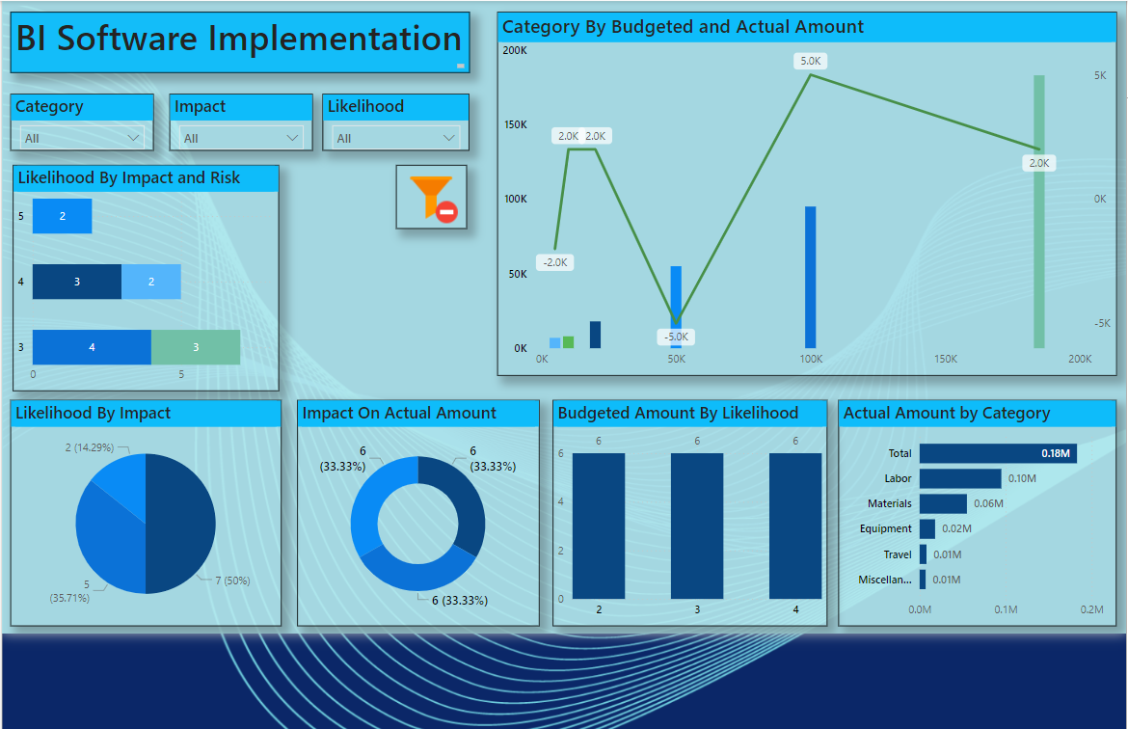

Slide 9
Conclusion
Implementing a BI software system can revolutionize how an organization handles and interprets data, leading to better business decisions and overall performance. This project will provide a thorough understanding of BI tools, project management practices, and data analysis methodologies.

Slide 10
Thank You

